Slide 1
CO₂ Reduction by Surface Chemistry
Group Ⅲ
Speaker: Yi Wei
Group Members: Qingyuan Zhang, Haoyu Wang, Erfei Zhang, Qianling Liu, Yi Wei

Slide 2
CONTENTS
Research Background
Case Study : in-situ XANES revealing CO₂-ethanol transformation
Conclusion and Perspective

Slide 3
01
Research Background

Slide 4
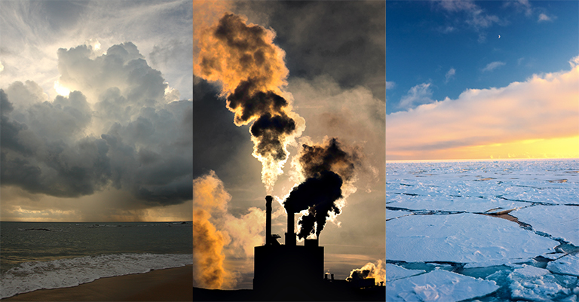
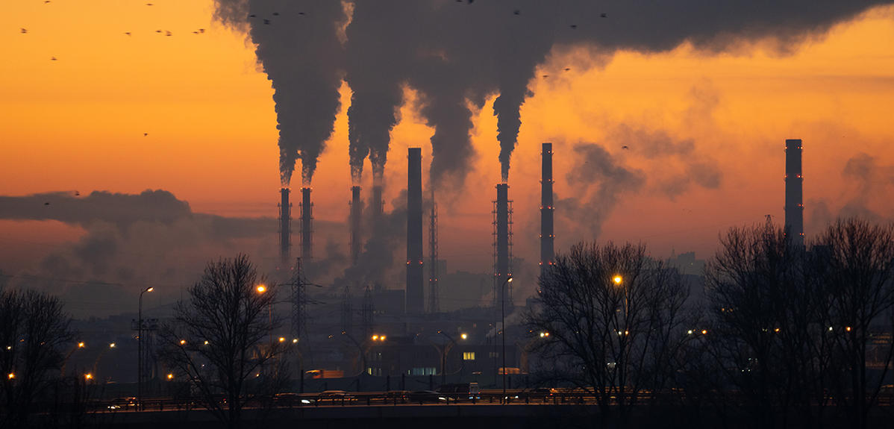
Environmental and Energy Problem
Greenhouse gases
cause global warming
Fossil energy depletion

Slide 5
Catalysis
Increase the kinetic energy of the reactants
reduce the activation energy
Higher reaction temperatures
higher energy consumption side reactions
Thermal catalysis
Light → Photocatalysts → exciton
poor efficiency and selectivity of surface redox
require specific light-absorbing materials
Photocatalysis
Facilitates electron transfer by applied potential
Low energy consumption, easy control of reaction conditions
Compatibility with other renewable energy sources
Electrocatalysis
Ochedi, F. et al. , Environmental Chemistry Letters, 2021, 19, 941-967.
Notes:
光催化：光催化依赖于光催化剂对光的吸收，从而产生电子-空穴对（激子）。整个光催化机制包括光吸收、电荷分离和光生载流子的迁移，然后是表面氧化还原反应。
与热催化和电催化相比，通常效率和选择性较低，且需要特定的吸光材料和最佳反应条件。
热催化：热催化是由热量驱动的，热量增加了反应物的动能，降低了反应发生所需的活化能。在CO2还原的情况下，催化剂为CO2吸附和活化提供活性位点。这些活性位点削弱了CO2中的C=O键，并促进了与其他反应物（如氢气或一氧化碳）的反应，以形成所需的产物。
需要较高的反应温度，从而导致更高的能耗和潜在的副反应。
电催化：电催化涉及催化剂和电极-电解质界面反应物之间的电子转移。在CO2还原中，施加的电势驱动反应，催化剂为CO2吸附、活化以及与其他物种（如质子和电子）的反应提供活性位点。电势降低了反应的能垒，其机理包括催化剂、CO2和其他反应物之间的电子转移，以形成所需的产物。
可以在相对较低的温度下操作，与热催化相比降低了能耗；允许对反应条件（例如，电势、电流）进行精确控制，以优化效率和选择性；与可再生能源（如太阳能、风能）兼容，实现可持续低碳能源转换。

Slide 6
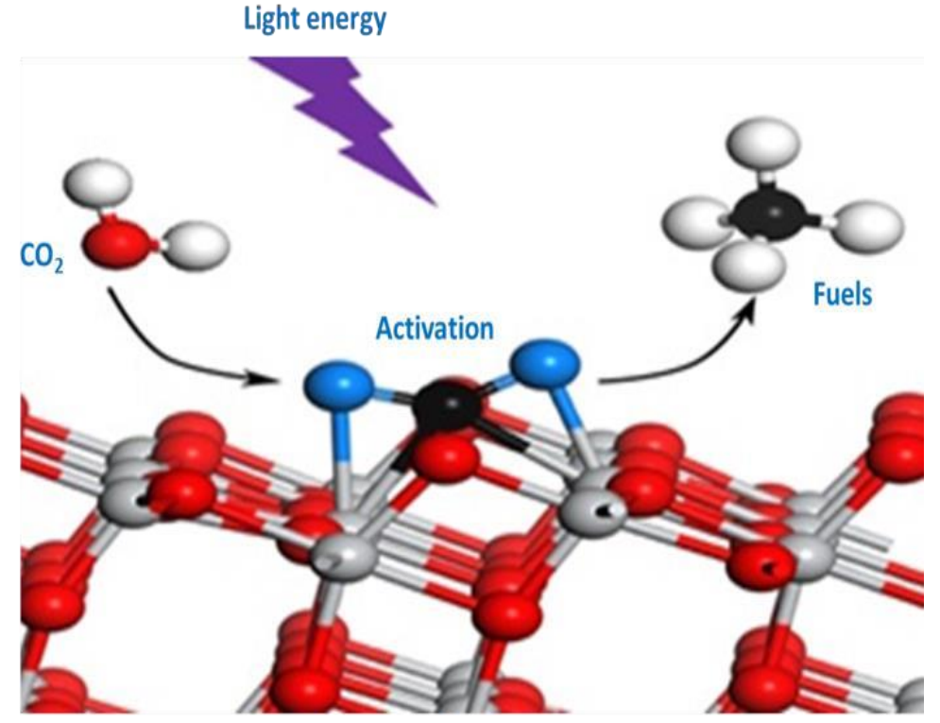
CO₂RR process
Electron potential
Adsorption: CO₂ molecules first form an adsorbed state on the surface of the catalyst.
Activation: When CO₂ molecules are adsorbed on the catalyst surface, the interaction with the active sites on the catalyst surface may cause the C=O bond to bend, thereby reducing the activation energy.
Conversion: The activated CO₂ molecules will react with reducing agents to produce the corresponding reduced products.
Desorption: The produced reduced products desorb from the catalyst surface, releasing the reduced products.
Notes:
吸附：CO2分子首先在催化剂表面形成吸附态。
活化：CO2在催化剂表面上的活化是实现还原的关键。通常情况下，CO2分子的线性结构使其在热力学和动力学上相对稳定。然而，当CO2分子在催化剂表面吸附时，由于与催化剂表面活性位点的相互作用，其C=O键可能发生弯曲，从而降低了活化能。
转化：活化后的CO2分子将与还原剂（例如氢气、水、甲醇等）发生反应，生成相应的还原产物。在这一过程中，催化剂表面上的活性位点起到关键作用，可以有效地调控反应的活性和选择性。
脱附：生成的还原产物从催化剂表面脱附，释放出有价值的化学品或燃料。

Slide 7
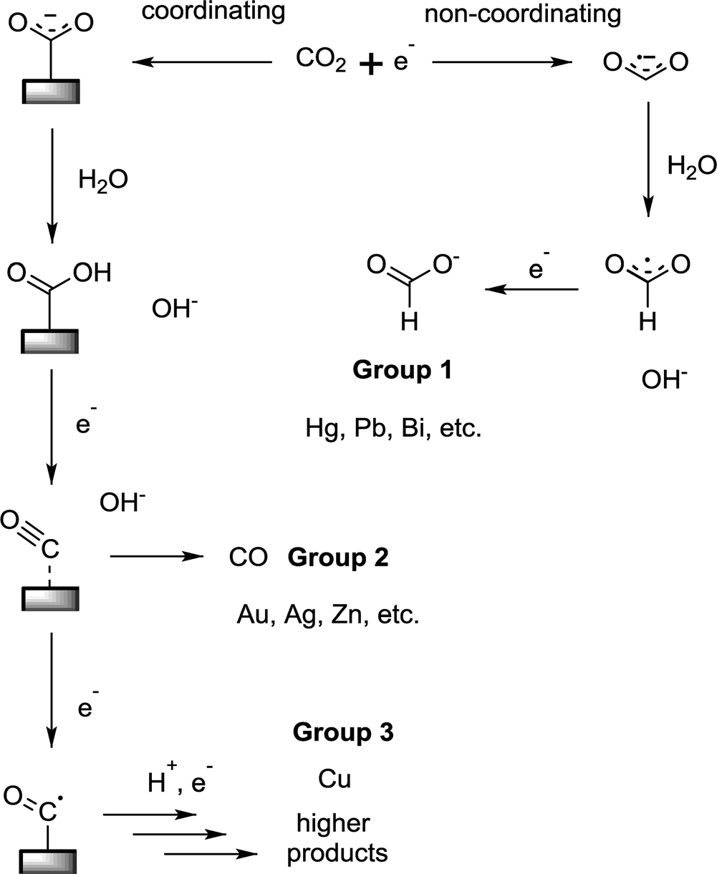
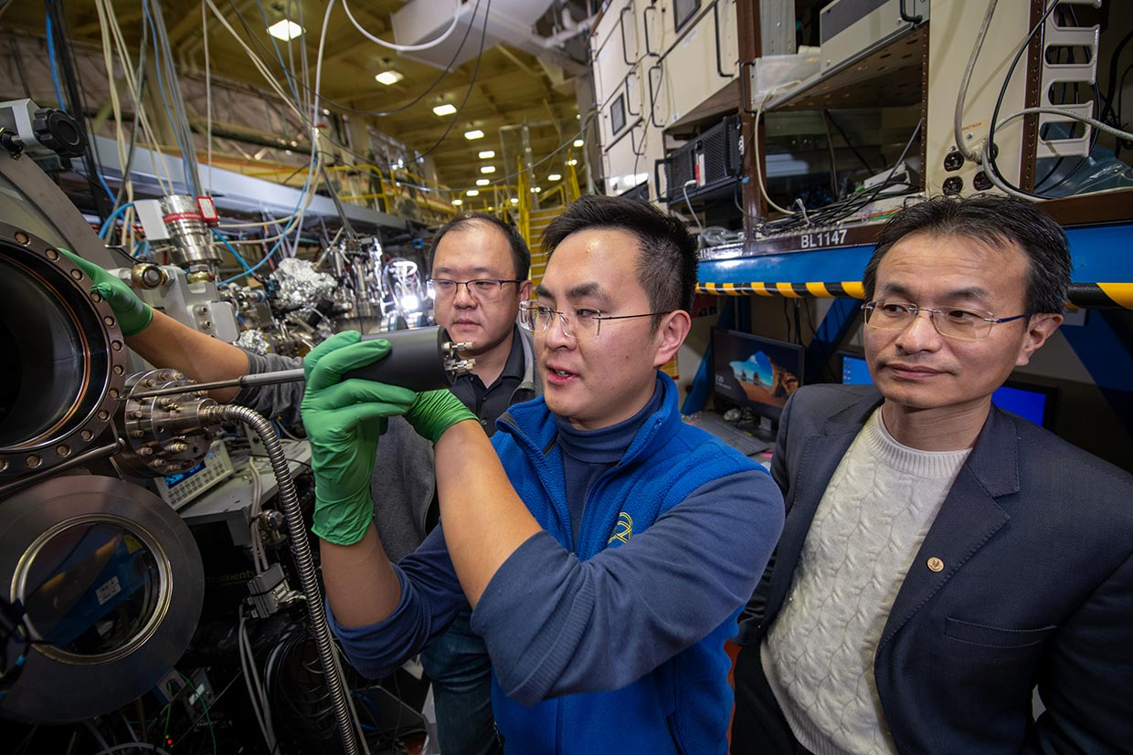
CO₂ reduction scheme
In-situ Characterization Techniques:
X-ray diffraction/scattering (XRD)
X-ray photoelectron spectroscopy (XPS)
X-ray absorption spectroscopy (XAS)
Raman spectroscopy
Infrared (IR) spectroscopy
transmission electron microscopy (TEM)
Pt, Ni, Fe, Ti
Jones, J.-P.et al. Israel Journal of Chemistry 2014, 54 (10), 1451-1466.
Notes:
上图描述了不同电极的二氧化碳电催化还原的路径。第一步和电子的结合很重要，这决定了下一步的反应。第一组电极不能结合CO2负这个中间体且不能还原CO。第二组电极能结合CO2负但不能还原CO。第三组电极能结合CO2负且能还原CO。

Slide 8
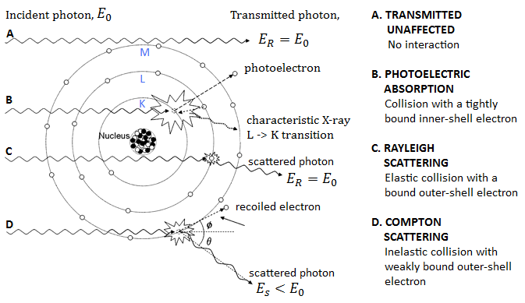
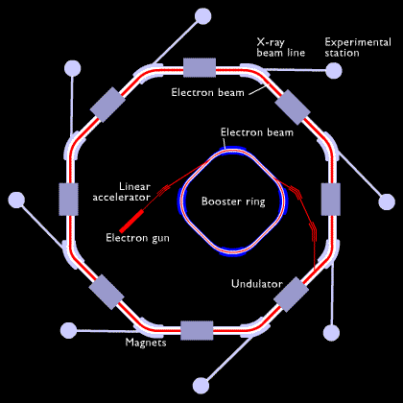
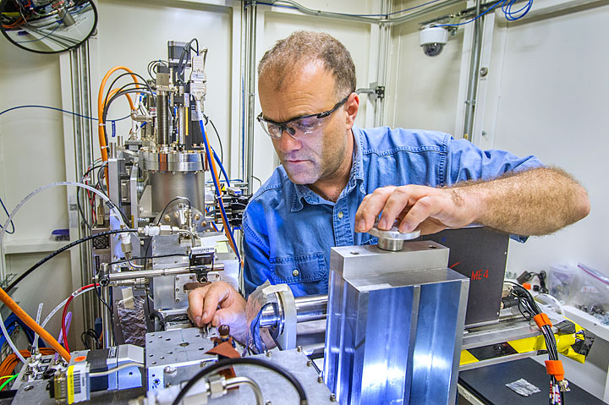
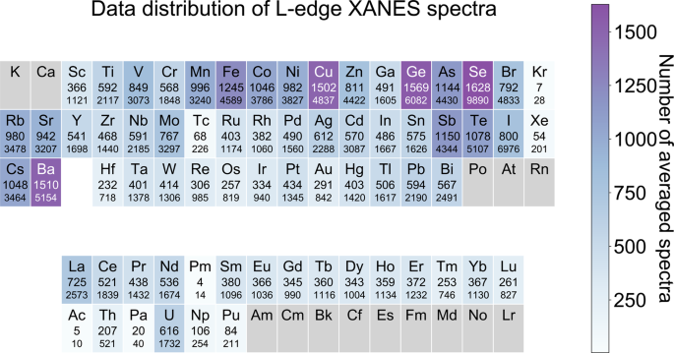
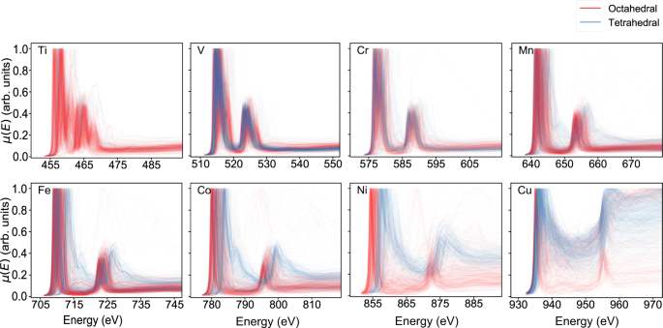
Synchrotron X-ray In-situ Characterization
Synchrotron Accelerator
XAS Experimental Station
X-ray Matter Interactions

Slide 9
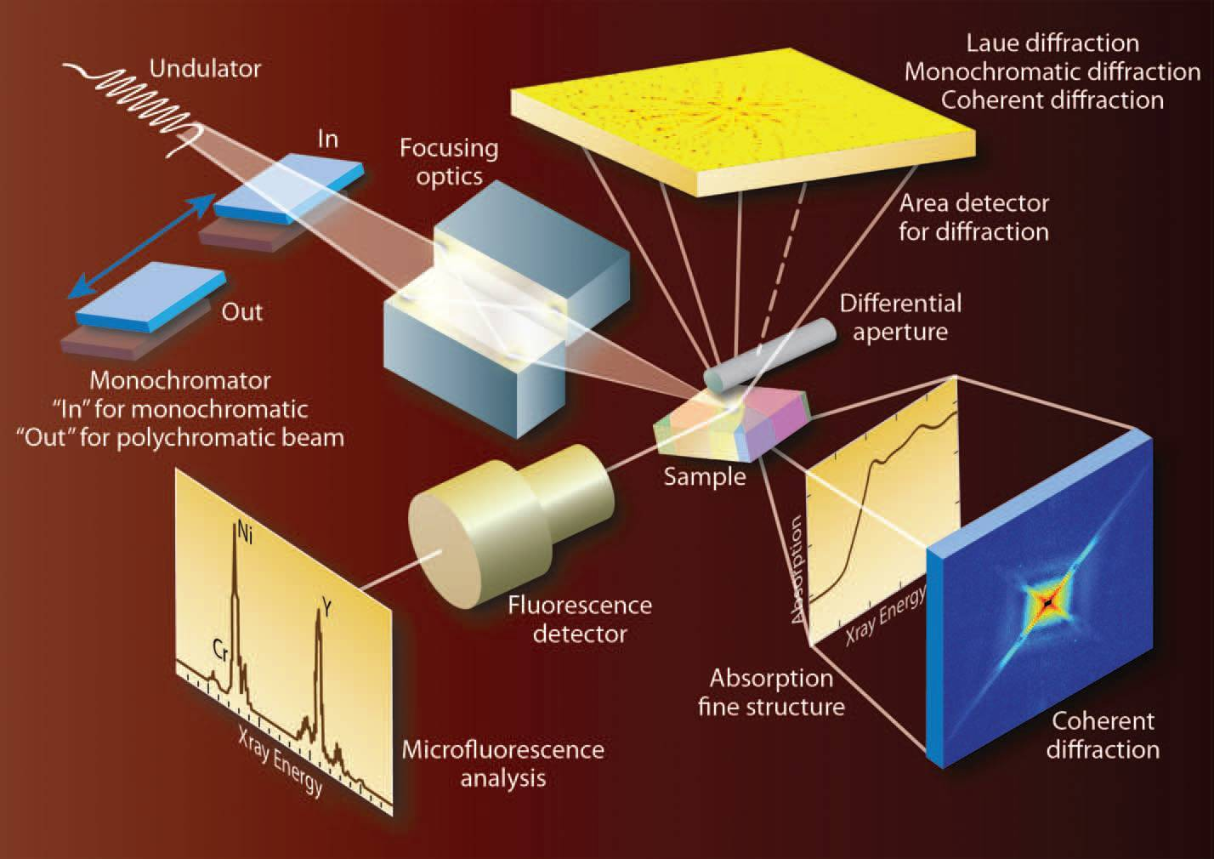
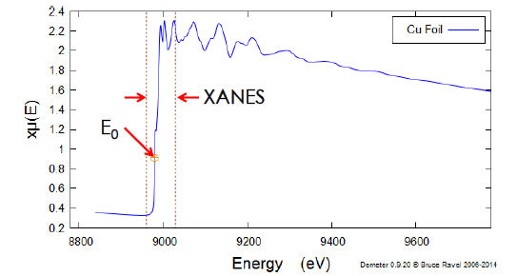
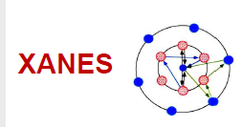
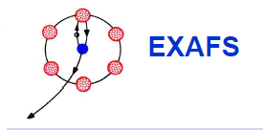
X-ray Adsorption Spectra
multiple-scattering induced
EXAFS
single-scattering induced
Fourier Transformation
$χ\left(k\right)$ Extraction
E Space
K Space
R Space
Fourier Transformation
$$k=\frac{\sqrt{2m(E−E_{0})}}{ℏ}$$
Fourier transformation
$$\tilde{χ}\left(r\right)=FT\left[χ\left(k\right)\right]=\frac{1}{2π}\int_{0}^{∞}{χ\left(k\right)W\left(k\right)e^{\left(i2kr\right)}dk}$$
E-k transformation

Slide 10
Case Study :
02
In-situ XANES revealing the CO₂-Ethanol transformation

Slide 11
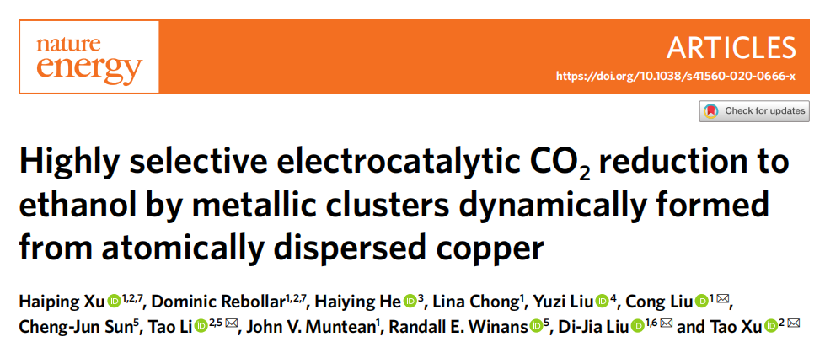
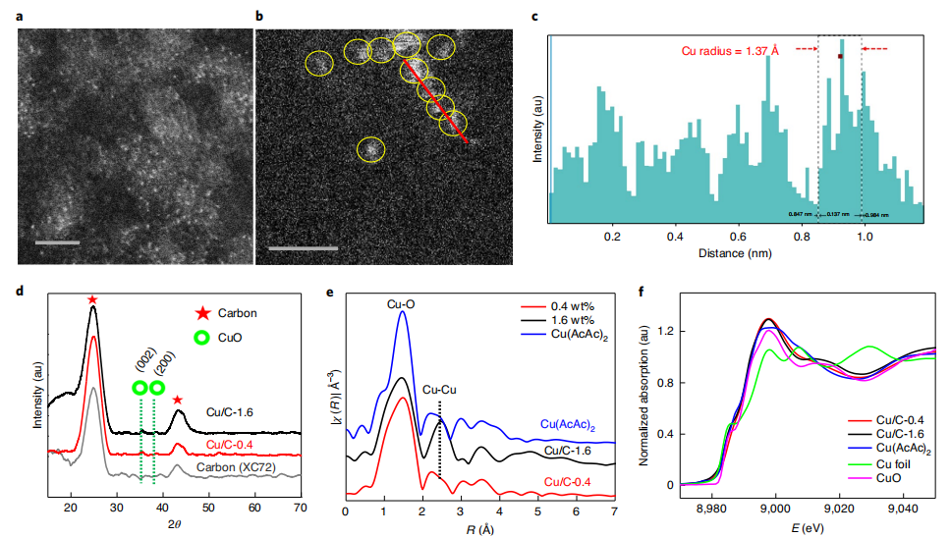
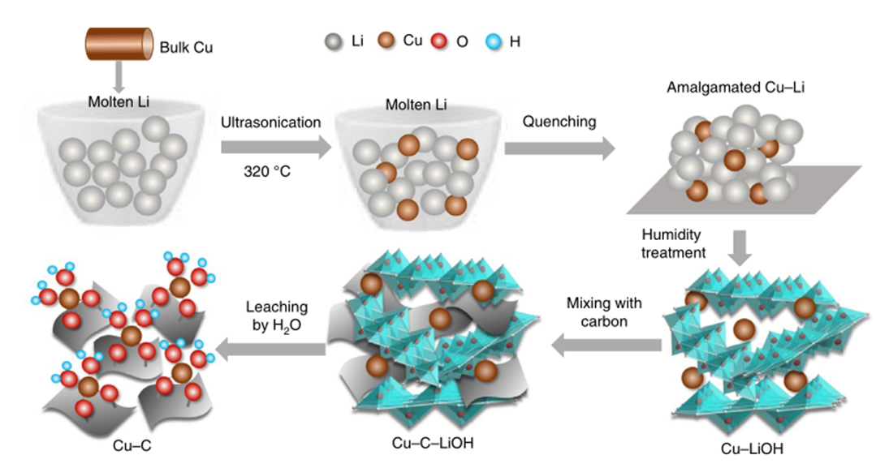
Catalysts system introduction
2. Catalyst structure characterizations
1. Catalyst synthesis
HAADF–STEM images
XRD patterns
Fourier transform of k²-weighted R space χ EXAFS data
Cu k-edge normalized XANES spectra
Step-by-step preparation of the carbon-supported Cu SA catalyst using an amalgamated Cu–Li method.
Xu, H.et al. Nature Energy 2020, 5 (8), 623-632.

Slide 12
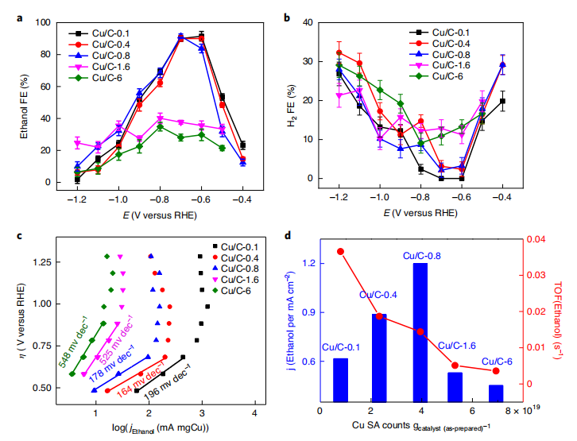
Electrocatalytic Performance
3. Electrocatalytic CO₂RR measurement over Cu/C-0.4
4. Electrochemical properties of Cu/C at different loading
LSVs of Cu/C-0.4 in Ar and CO₂ saturated 0.1 M KHCO₃
FE and the product distribution at different polarization potentials
FE and current density as a function of time
FE of CO₂-to-ethanol at different potentials
FE of H₂ formation at different potentials
Tafel plots of polarization overpotential (η) versus ethanol partial current density
The partial current density for ethanol conversion (blue bar) and TOF of ethanol (red line)
Xu, H.et al. Nature Energy 2020, 5 (8), 623-632.

Slide 13
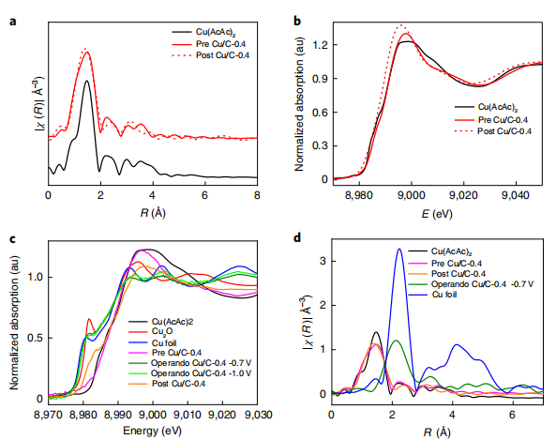
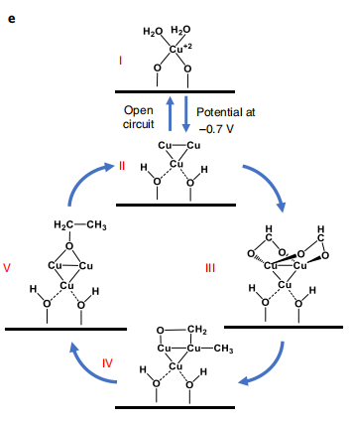
Atom manipulation
Fourier transform of k²-weighted R space χ EXAFS data
Cu k-edge normalized XANES spectra
Catalytical Mechanism
5. Operando XAS study on the Cu CO₂RR active site.
In situ Cu k-edge XANES spectra
Fourier transform of k²-weighted χ function in R space of the catalysts
The hypothesized reaction mechanism
Type of particles
Xu, H.et al. Nature Energy 2020, 5 (8), 623-632.

Slide 14
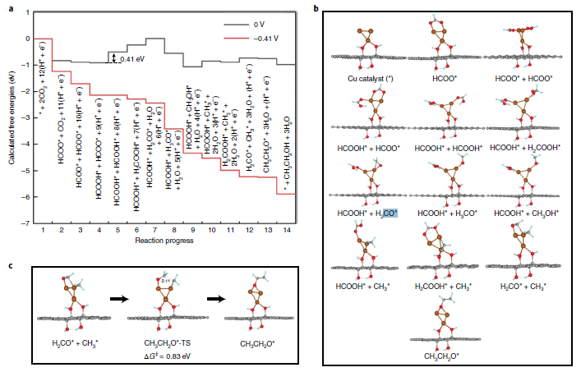
Atom manipulation
Catalytical Mechanism
6. DFT calculations
Calculated reaction pathway of electrochemical reduction of CO₂ to ethanol
Calculated structures of the catalyst and intermediate states
Reaction 12 → 13 with a transition state
Xu, H.et al. Nature Energy 2020, 5 (8), 623-632.

Slide 15
03
Conclusion and Perspective

Slide 16
Conclusion
In-situ XAS characterization provides the solid evidence for the active site, reaction intermediates and pathway.
Identification of the activity origin in different complicated catalysts system facilitates the development of more catalysts with high activity, selectivity and stabilization.
SACs or DACs could promote the catalytic performance through both enhancing the intrinsic activity and providing more active sites.
Notes:
为此，需要能够在反应条件下进行高分辨率表面翻新和局部活度测量的表征工具，以阐明电催化剂结构如何影响局部活度，以及电化学测量过程中电化学反应如何在电极-电解质界面进行。
扫描探针显微镜(SPM)是一种强大的工具，可以将表面性质和局部电化学活性可视化到原子尺度的原位，因此在研究多相电催化机制中发挥着重要作用。
这些高分辨率表征手段可以用于催化剂表面性质成像（成像表面形貌和局部电子结构），原位检测、纳米级电化学制图（量化单个纳米颗粒反应性能）、通过表面工程，如晶面控制、杂原子掺杂、缺陷工程和界面工程，实现了电催化剂的优化。电催化剂表面性质和活性的原子空间分辨率对于建立结构-性质-活性关系非常重要。
此外，最近提出了由人工智能驱动的自主SPM操作(DeepSPM)来进行连续的数据采集，使得使用人工操作难以实现的先进SPM方法成为可能。这也是SPM未来发展为表面反应提供更强观测手段的一个重要方向。

Slide 17
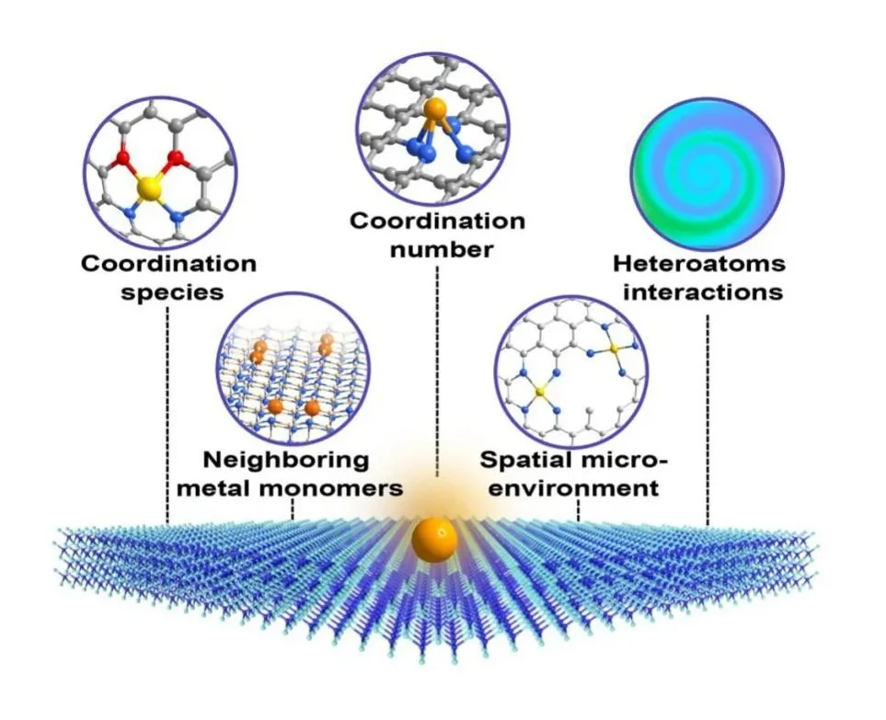
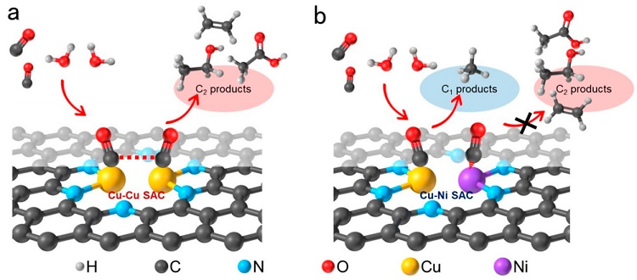
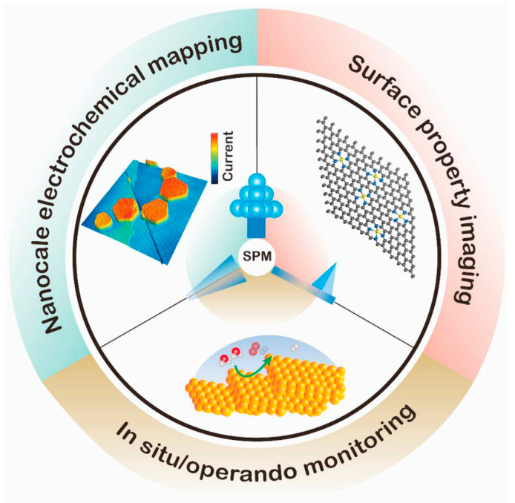
Perspective
Confirmation of different catalyst surface active sites to expand catalyst active sites
Catalysts that specifically construct higher density active sites
Potential of SPM employed on the in-situ characterization of CO₂ reduction
Intrinsic activity sites
High density activity sites
New operando techniques
Li, S. ACS Materials Letters 2021, 3 (12), 1729-1737.
Wang, Y. Matter 2021, 4 (11), 3483-3514.
Wu, X. Nano-Micro Lett. 13, 136 (2021).
Notes:
即使在广受好评的电催化系统中，如由孤立的金属氮(N)位点组成的单原子催化剂(SACs)中，缓慢的CO2RR动力学仍然没有解决。这是由于限制了单原子位点上反应物/中间体吸附/解吸的固有比例关系。因此，它们实现的电流密度仍然远远落后于商业水平(≥250mAcm−2)。
为此，我们可以尝试双原子催化剂(DAC)或构筑更加高密度活性位点的催化剂，以实现高效和经济的CO2RR，因为它们是SACs和传统的体/纳米颗粒/簇催化剂(原子组合)之间的桥梁。DAC可以通过协同调节CO2活化和中间形成/解吸来理想地克服单个孤立位点的限制，从而允许其相邻金属位点上的快速CO2RR动力学过程。
但合成方法的局限性和双原子位点基础研究的缺乏阻碍了高效CO2RR中dac的发展，因此需要我们寻找更加有效的多位点催化剂合成方法，所以还需要针对不同的催化剂探索表面反应机理，寻找合适的基体，实现原理可控。

Slide 18
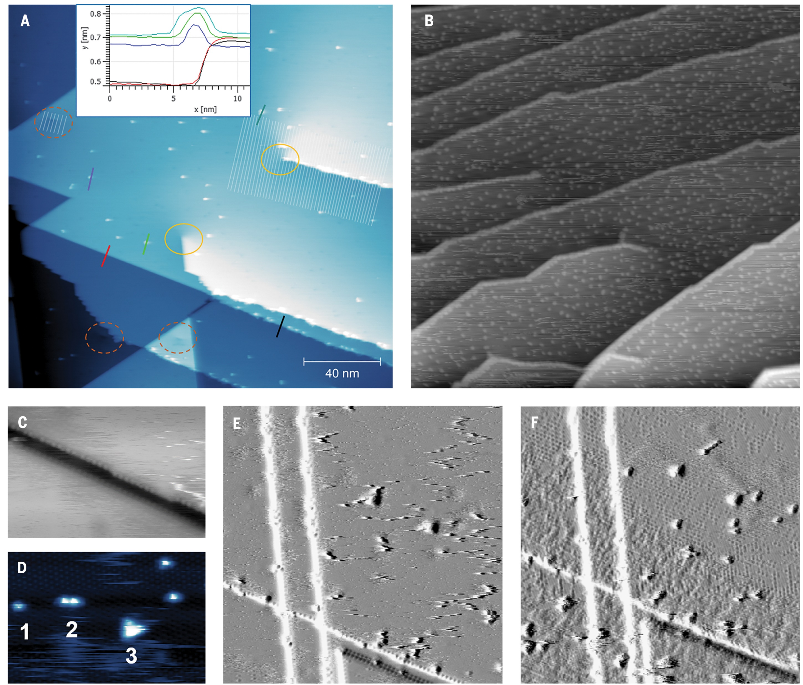
Perspective
STM images showing the effect of CO exposure on a defective Ni(111) surface.
Lang Xu et al. Science 380, 70-76(2023).

Slide 19
Thanks for Your Listening!

